Slide 1
POSIX THREADS
Veera Reddy

Slide 2
Contents
What is Thread?
Why use Threads?
Difference between process and threads
POSIX
Multi-threading
→ TGL id, pid, ppid, tid
mutex
Types of mutex

Slide 3
Need of threads
What happens when we use fork?
What happens in COW mechanism?
What happens when we use vfork?
What happens when we use thread?

Slide 4
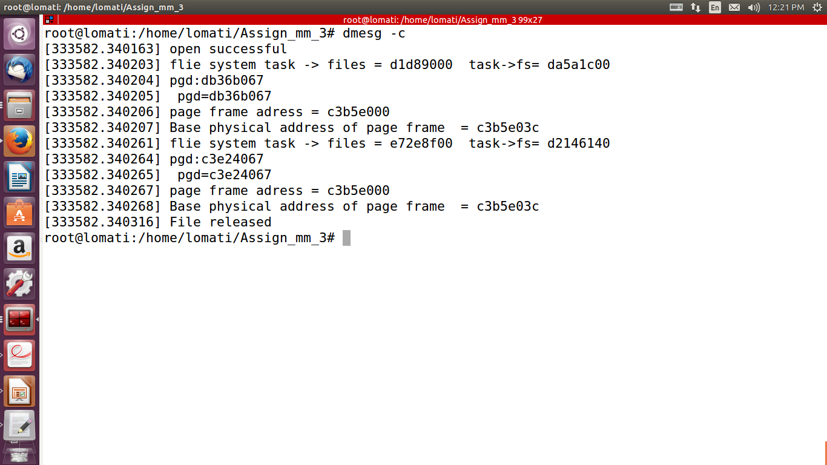
fork

Slide 5
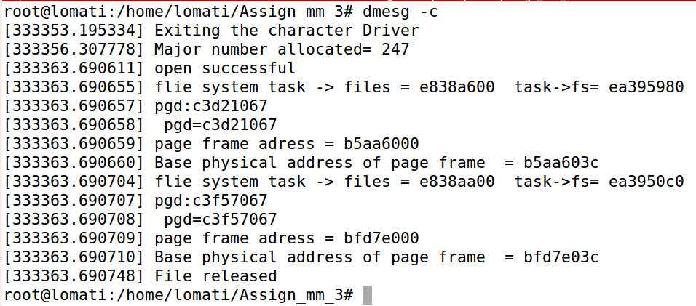
COW mechanism in FORK

Slide 6
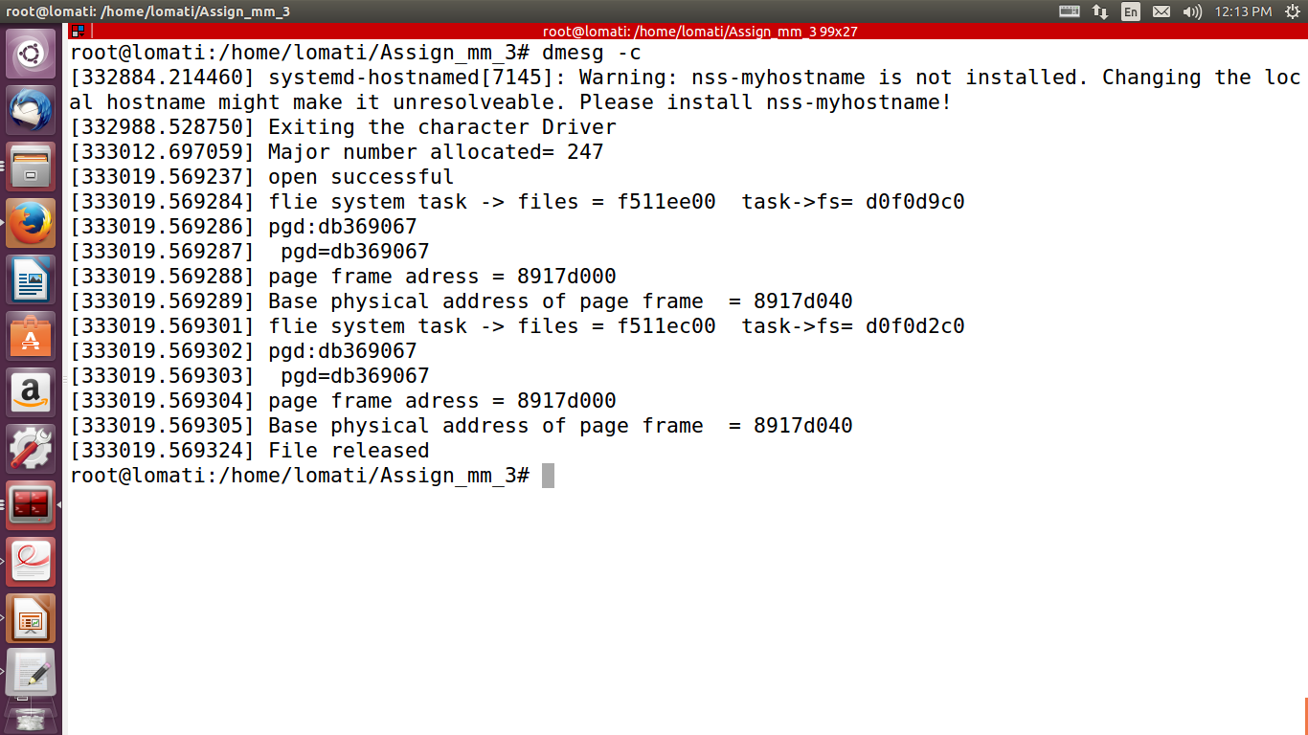
VFORK

Slide 7
SUMMARY
FORK(COW) | VFORK | THREAD
Doesn't share structures related to memory and VFS data structures | Shares Memory but doesn't share VFS data structures. | Shares both Memory and VFS data structures.
Doesn't share data page | Shares data page | Shares data page

Slide 8
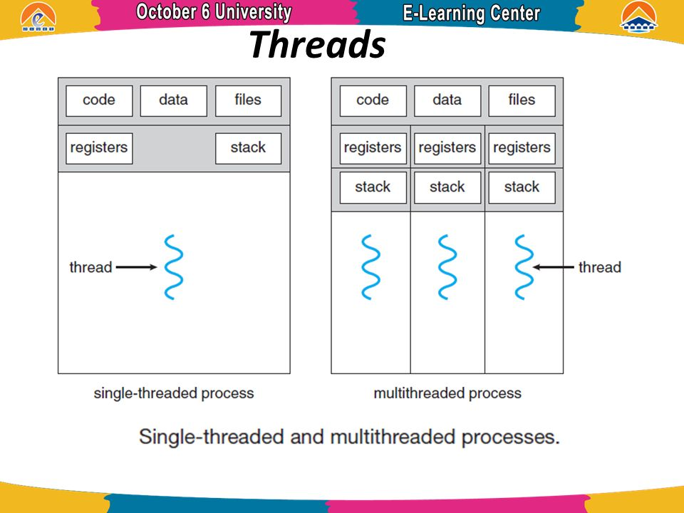
Threads Share?

Slide 9
POSIX Functions
Portable Operating System Interface (for UNIX) .
pthread_create
pthread_self
pthread_equal
pthread_join
pthread_exit
pthread_detach

Slide 10
Example pthread_create
#include <pthread.h>
pthread_attr_t tattr;
/* set the thread detach state */ pthread_attr_setdetachstate(&tattr,PTHREAD_CREATE_DETACHED);
/* to set scope */
pthread_attr_setscope(&tattr,PTHREAD_SCOPE_SYSTEM);
/* set thread stack size */
PTHREAD_STACK_MIN + 0x4000
pthread_attr_setschedparam (&tattr,&param);

Slide 11
Multi threading
TGL id : getpid();
Tid : gettid();
Ppid : getppid();

Slide 12
Problems With Threads
Dangerous Consequences
No Synchronization by default
Solutions:
1.Design should be Careful
2. Mutual exclusion

Slide 13
Mutual Exclusion
Mutual Exclusion is the locking mechanism
Different functions in mutual exclusion
→ pthread_mutex_init() ;
→ pthread_mutex_lock() ;
→ pthread_mutex_trylock() ;
→ pthread_mutex_unlock() ;
→ pthread_mutex_destroy() ;

Slide 14
Mutex types
PTHREAD_MUTEX_ERROR_CHECK
PTHREAD_MUTEX_RECURSIVE
PTHREAD_MUTEX_SHARED
PTHREAD_PRIO_INHERIT

Slide 15
Mutex static initialization
If you initialize mutex by using macro
PTHREAD_MUTEX_INITIALIZER.
pthread_mutex_t mutex= PTHREAD_MUTEX_INITIALIZER
pthread_mutex_t mutex =PTHREAD_RECURSIVE_MUTEX_INITIALIZER

Slide 16

Questions?

Slide 17


